Slide 1
How the human rights of children and people with disabilities are protected in the UK and Ireland
Brice Dickson, 28 June 2017

Slide 2
SOME RELEVANT LITERATURE
Annette Faye Jacobsen, ‘Children’s Rights in the European Court of Human Rights – An Emerging Power Structure’ (2016) 24 IJCR 548
Brice Dickson and Conor McCormick, ‘The Right to Education for Humanity’ (2016) 67 NILQ 409
Oliver Lewis, ‘Disabling Legal Barriers’ [2017] EHRLR 49
Asia/Pacific Forum of NHRIs, Manual on the Role of NHRIs in Advancing the Rights of Persons with Disabilities (2017)

Slide 3
THE SCOPE OF THIS TALK
Ireland is an independent nation
The UK (of GB and NI) is not a federation but a country of regions to which some powers have been devolved
Scotland, Wales and Northern Ireland can protect human rights differently from England and Ireland
THE UK AND IRELAND
DEVOLVED POWERS

Slide 4
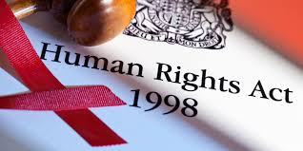
HOW CHILDREN ARE PROTECTED IN THE UK AND IRELAND
National mechanisms
Child protection legislation
Human rights legislation
Equality (anti-discrimination) legislation
Ombudsman institutions
NGO services and campaigns
International mechanisms
Applications to European Court of Human Rights
Complaints to other treaty-monitoring bodies
Periodic reports by treaty-monitoring bodies
Visits and reports by Rapporteurs

Slide 5
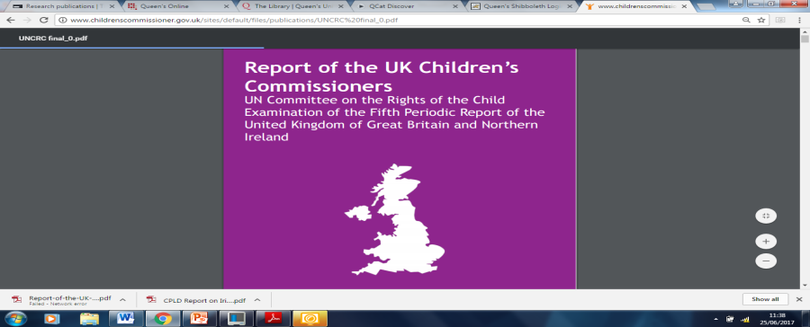
OMBUDSMAN INSTITUTIONS
Children’s Commissioner for England
Children’s Commissioner for Wales
Children and Young People’s Commissioner Scotland
Northern Ireland Commissioner for Children and Young People (NICCY)
Report of the UK Children’s Commissioners on the UK’s Fifth Periodic Report to the UN Committee

Slide 6
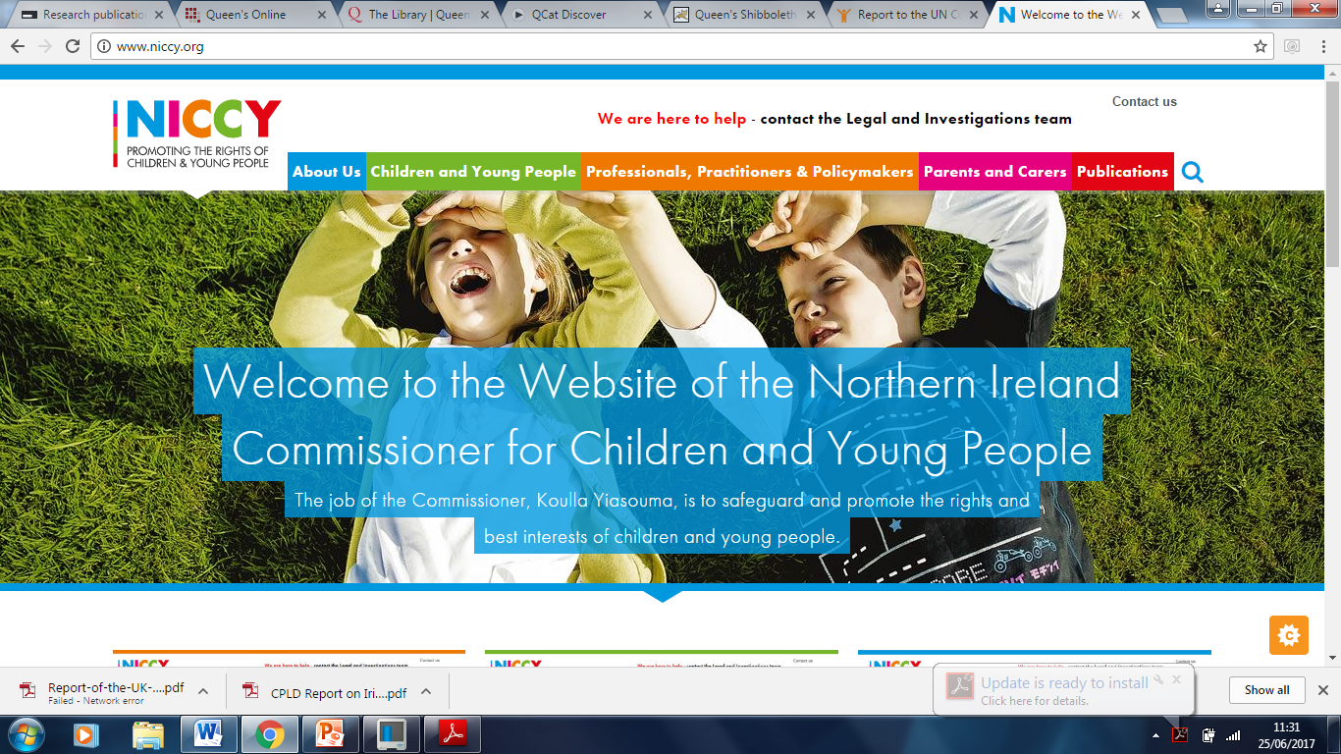

Slide 7
CHILD PROTECTION IN THE UK
The ECHR is part of UK law, but the UN Convention on the Rights of the Child and its ‘best interests’ principle (Article 3) are not
Courts have a duty to make the child’s welfare the paramount consideration when deciding any question relating to the child
The influence of the UNCRC is growing:
- the SG case [2015] UKSC 16
- reliance by the ECtHR on UNCRC standards,
e.g. in Jeunesse v The Netherlands (2014)

Slide 8
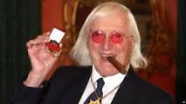
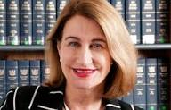
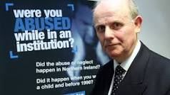
CHILD SEXUAL ABUSE
The Independent Inquiry into Child Sexual Abuse in England and Wales (ongoing since 2014)
Report of the Historical Institutional Abuse Inquiry in Northern Ireland (2017), covering the period 1922 to 1995

Slide 9
VARIATIONS IN THE REGIONS
SCOTLAND
Children’s Hearings (Scotland) Act 2011
Children and Young People (Scotland) Act 2014
NORTHERN IRELAND
Northern Ireland Act 1998: ‘equality schemes’
Children’s Services Co-operation Act (NI) 2015
Addressing Bullying in Schools Act (NI) 2016
WALES
National Action Plan 2009
Rights of Children and Young Persons (Wales) Measure 2011

Slide 10
CHILD PROTECTION IN IRELAND
The ECHR is part of Irish law, but the UN Convention on the Rights of the Child is not
The Children Act 2001 sets out how children are to be protected in a wide variety of areas
Only persons arranging private foster care for a child must regard the child's welfare as the first and paramount consideration (s 16)
Ombudsman for Children (since 2004)
Inquiries into child abuse (Ryan Commission, 2009), covering abuses from 1914 to 1999

Slide 11
HOW PEOPLE WITH DISABILITIES ARE PROTECTED BY LAW IN THE UK
Human Rights Act 1998
Equality Act 2010:
- employment
- access to goods and
services
- access to premises
- education
- transport
public sector equality duty
compensation for discrimination

Slide 12
HOW PEOPLE WITH DISABILITIES ARE PROTECTED BY LAW IN IRELAND
Equal Status Acts, 2000 and 2012
ECHR Act 2003
Equality Acts, 2004 and 2015
Disability Act, 2005

Slide 13
UN CONVENTION ON THE RIGHTS OF PERSONS WITH DISABILITIES
Ireland has not yet ratified the UNCRPD (Russia ratified in 2012)
UK ratified the UNCRPD, and the Optional Protocol No 1, in 2009 and it reported in 2011
Visit to UK by UN Special Rapporteur on Adequate Housing, 2013
In 2015-16 the Committee on RPD chose the UK for its first ever inquiry under the Optional Protocol
The UK government rejected all of the Committee’s recommendations
The Committee on RPD considered the UK’s 2011 report in March 2017 and will report in August

Slide 14
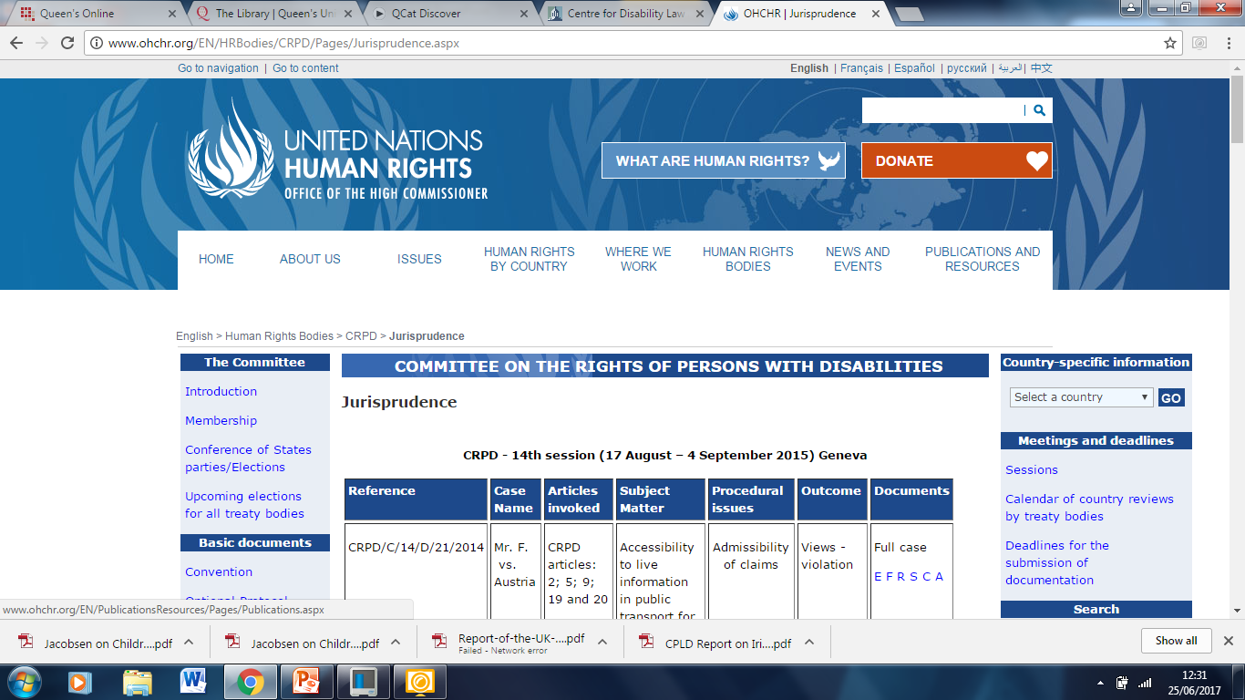

Slide 15
UN SPECIAL RAPPORTEURS
Ms Maud de Boer-Buquicchio
Ms Catalina Aguilar

Slide 16
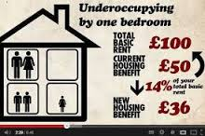
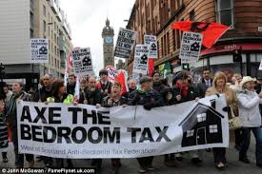
THE UK’S ‘BEDROOM TAX’

Slide 17
DISABILTY IN THE UK AND ‘THE BEDROOM TAX’
Equality and Human Rights Commission, 2012
Parliamentary Joint Committee on Human Rights, 2012
Social Security Advisory Committee, 2013
Petition debated in Parliament, 2014
National Institute of Economic and Social Research, 2014
Work and Pensions Committee, 2014
Joseph Rowntree Foundation, 2014
Court cases: Hardy (2015, HC); MA (2016; UKSC)
Variations in Scotland and Northern Ireland

Slide 18
‘THE BENEFIT CAP’ £20,000 for families £13,400 for single people

Slide 19
COURT CHALLENGES TO ‘THE BENEFIT CAP’
Some people receiving disability-related benefits have always been exempt from the cap
The High Court held in Hurley (2015) that the cap was discriminatory against disabled people
The Supreme Court held in SG (2015) that the cap was not discriminatory against women
The Regulations were changed in 2016
The High Court held in DA (2017) that the cap was still discriminatory against young children of single parents

Slide 20
CURRENT DISABILITY ISSUES
UNITED KINGDOM
IRELAND
Welfare benefits
Mental illnesses
Air travel: Stott v Thomas Cook Ltd (2014, UKSC)
Bus travel: FirstGroup plc v Paulley (2017, UKSC)
Risk of poverty
Inadequate housing
Education: Sinnott v Minister of Education (2001)
Ratifying the UNCRPD (draft Bill, 2016)

Slide 21
Спасибо за прослушивание.
У вас есть вопросы?
Thanks for listening.
Do you have any questions?

